Slide 1
SER 334 A Session
Exam 3 Review Session
February 22nd 2024
7:00 pm - 9:00 pm MST

Slide 2
{
Agenda
Practice Exam
Sample Problems
Q&A

Slide 3
SI Session Expectations
Thanks for coming to the SER 334 SI session. We have a packed agenda and we are going to try to get through as many of our planned example problems as possible. This session will be recorded and shared with others.
If after this you want to see additional examples, please visit the drop-in tutoring center.
We will post the link in the chat now and at the end of the session.
tutoring.asu.edu
Please keep in mind we are recording this session and it will be made available for you to review 24-48 hours after this session concludes.
Finally, please be respectful to each other during the session.

Slide 4

Interact with us:
Zoom Features
Zoom Chat
Use the chat feature to interact with the presenter and respond to presenter’s questions.
Annotations are encouraged

Slide 5

Opens: Monday February 26th
@ 2 AM
SER 334
Exam 2 Review
Exam Info Page
Front and Back!
Closes: Tuesday February 27th
@ 11:59 PM
Modules 9 - 12
Practice Exam
110 minutes
Pro Tip: Take a peek at the programming questions before getting started
~40 seconds per point
~28 questions

Slide 6
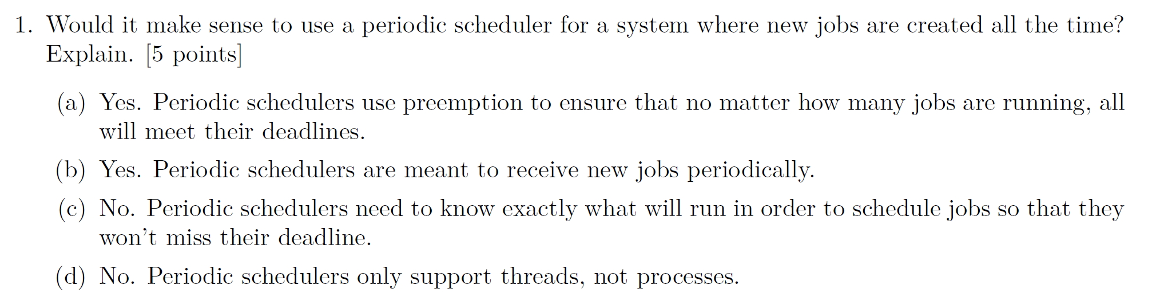
SER 334
Exam 3 Review

Slide 7
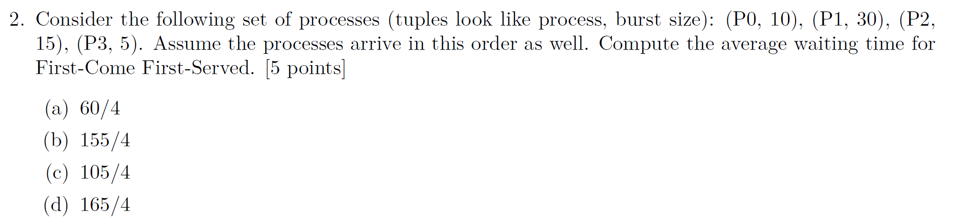
SER 334
Exam 3 Review

Slide 8
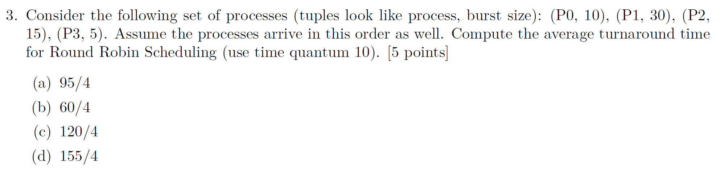
SER 334
Exam 3 Review

Slide 9
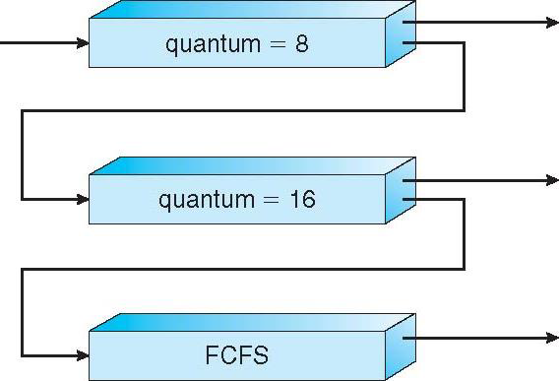
SER 334
Exam 3 Review

Slide 10
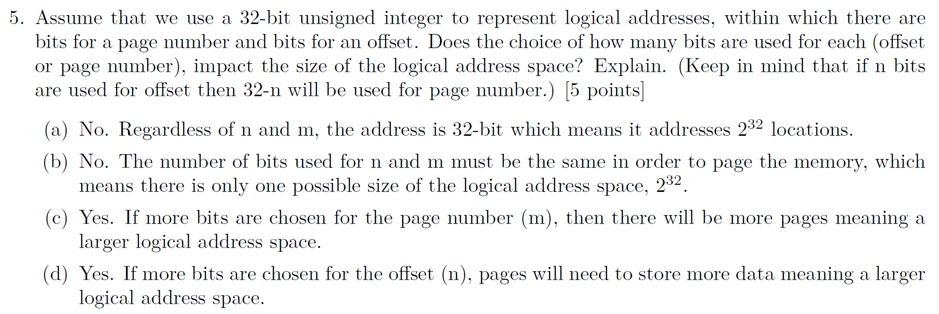
SER 334
Exam 3 Review

Slide 11
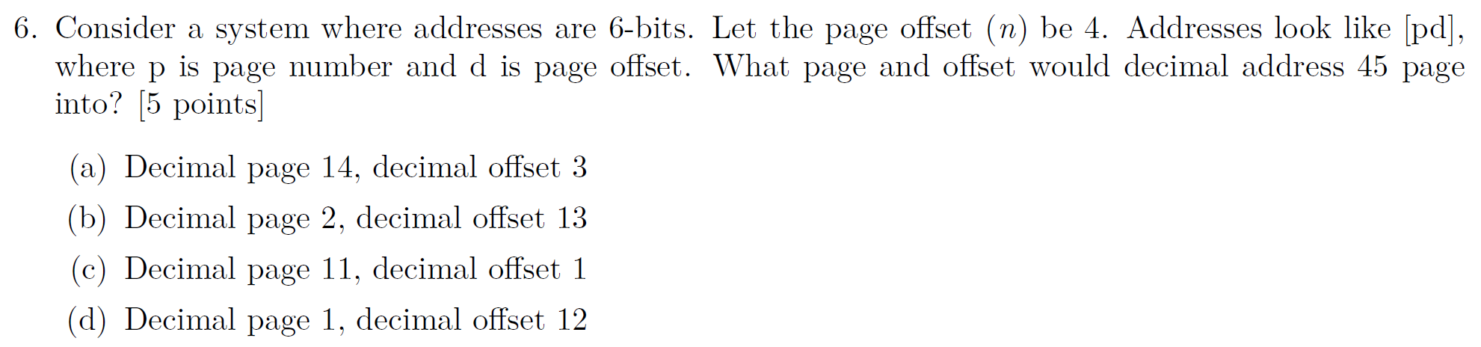
SER 334
Exam 3 Review

Slide 12
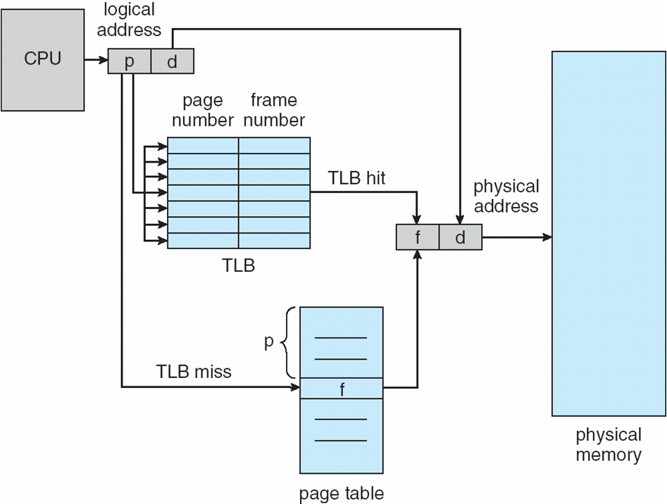
SER 334
Exam 3 Review

Slide 13
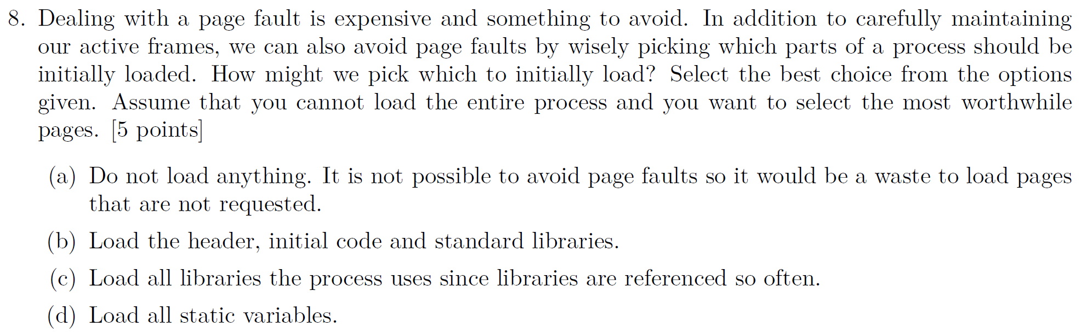
SER 334
Exam 3 Review

Slide 14
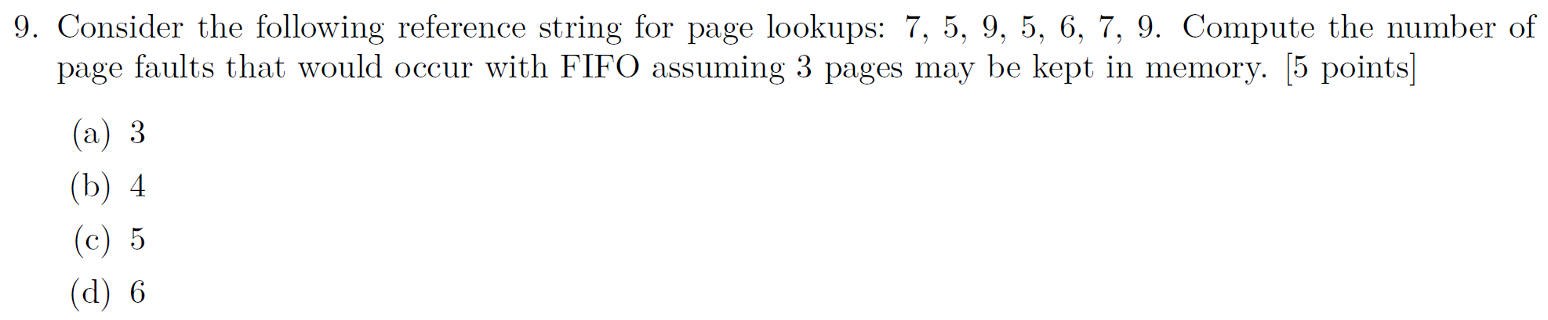
SER 334
Exam 3 Review

Slide 15
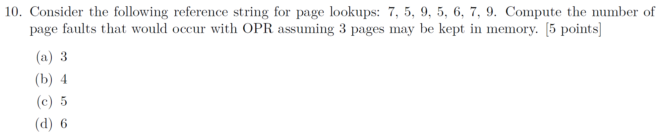
SER 334
Exam 3 Review

Slide 16
SER 334
Exam 3 Review

Slide 17
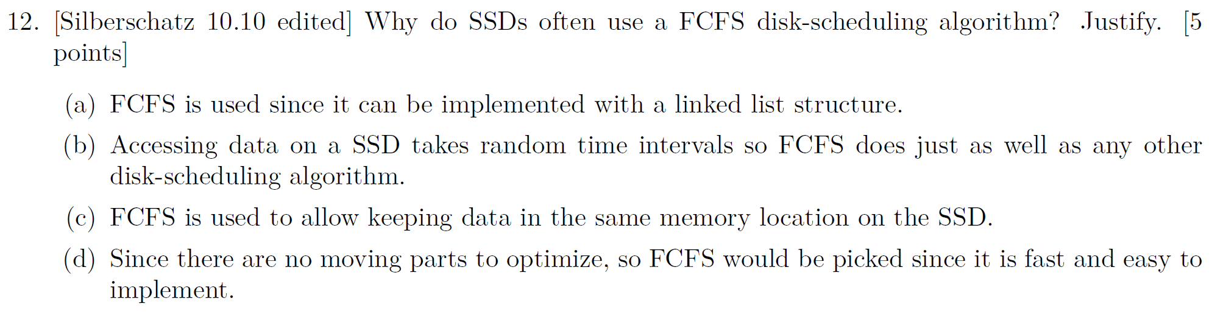
SER 334
Exam 3 Review

Slide 18
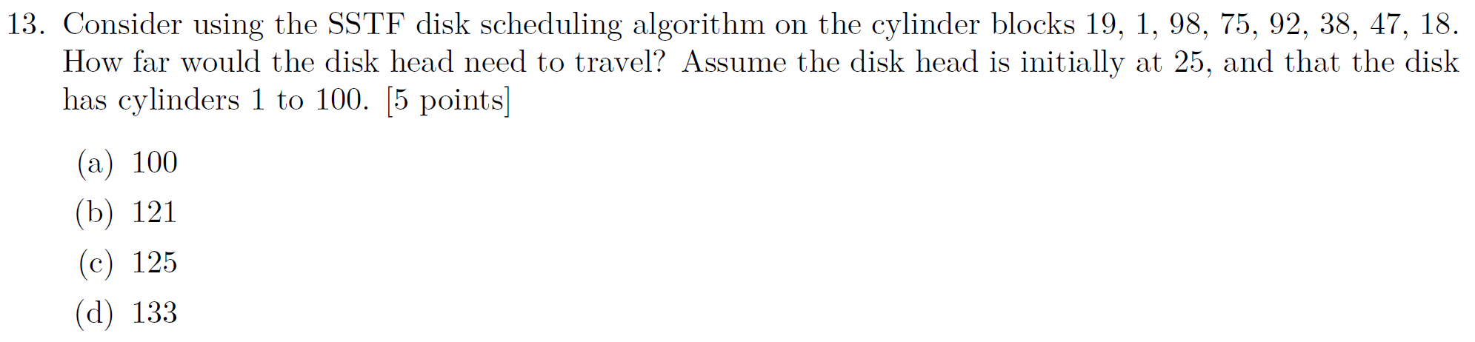
SER 334
Exam 3 Review
Total:

Slide 19
SER 334
Exam 3 Review

Slide 20
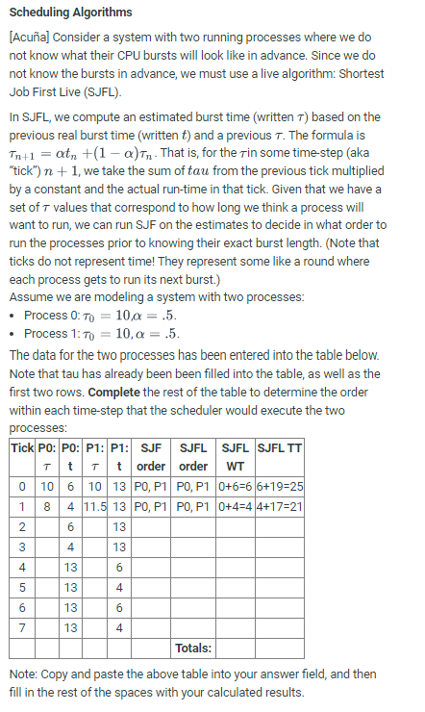
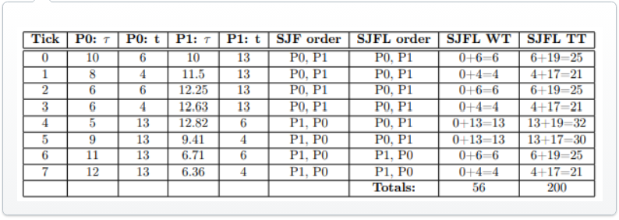
SER 334
Exam 3 Review
Tick | P0 𝒯 | P0 𝓉 | P1 𝒯 | P1 𝓉 | SJF Order | SJFL Order | SJFL Wait | SJFL Turn.
0
1
2
3
4
5
6
7
 |  |  |  |  |  | Totals:

Slide 21
SER 334
𝒯_{n+1}= a(𝓉_{n}) + (1 - a)𝒯_{n}
𝒯_{n+1}= (0.5)(𝓉_{n}) + (0.5)𝒯_{n}
Exam 3 Review
Tick | P0 𝒯 | P0 𝓉 | P1 𝒯 | P1 𝓉 | SJF Order | SJFL Order | SJFL Wait | SJFL Turn.
0 | 16 | 4 | 20 | 22
1 | 16 | 10 | 18 | 22
2 |  | 4 |  | 22
3 |  | 10 |  | 22
4 |  | 22 |  | 4
5 |  | 22 |  | 10
6 |  | 22 |  | 4
7 |  | 22 |  | 10
 |  |  |  |  |  | Totals:

Slide 22
SER 334
𝒯_{n+1}= a(𝓉_{n}) + (1 - a)𝒯_{n}
𝒯_{n+1}= (0.5)(𝓉_{n}) + (0.5)𝒯_{n}
Exam 3 Review
Tick | P0 𝒯 | P0 𝓉 | P1 𝒯 | P1 𝓉 | SJF Order | SJFL Order | SJFL Wait | SJFL Turn.
0 | 12 | 4 | 20 | 22 | P0, P1
1 | 16 | 10 | 18 | 22 | P0, P1
2 |  | 4 |  | 22 | P0, P1
3 |  | 10 |  | 22 | P0, P1
4 |  | 22 |  | 4 | P1, P0
5 |  | 22 |  | 10 | P1, P0
6 |  | 22 |  | 4 | P1, P0
7 |  | 22 |  | 10 | P1, P0
 |  |  |  |  |  | Totals:

Slide 23
SER 334
𝒯_{n+1}= a(𝓉_{n}) + (1 - a)𝒯_{n}
𝒯_{n+1}= (0.5)(𝓉_{n}) + (0.5)𝒯_{n}
Exam 3 Review
Tick | P0 𝒯 | P0 𝓉 | P1 𝒯 | P1 𝓉 | SJF Order | SJFL Order | SJFL Wait | SJFL Turn.
0 | 12 | 4 | 20 | 24 | P0, P1
1 | 16 | 10 | 18 | 24 | P0, P1
2 | 13 | 4 | 21 | 24 | P0, P1
3 | 8.5 | 10 | 22.5 | 24 | P0, P1
4 | 9.25 | 24 | 23.25 | 4 | P1, P0
5 | 16.625 | 24 | 16.625 | 10 | P1, P0
6 | 20.3125 | 24 | 13.3125 | 4 | P1, P0
7 | 22.15625 | 24 | 8.65625 | 10 | P1, P0
 |  |  |  |  |  | Totals:

Slide 24
SER 334
We don’t know the actual burst time yet!
𝒯_{n+1}= a(𝓉_{n}) + (1 - a)𝒯_{n}
𝒯_{n+1}= (0.5)(𝓉_{n}) + (0.5)𝒯_{n}
Exam 3 Review
Tick | P0 𝒯 | P0 𝓉 | P1 𝒯 | P1 𝓉 | SJF Order | SJFL Order | SJFL Wait | SJFL Turn.
0 | 12 | 4 | 20 | 24 | P0, P1 | P0, P1
1 | 16 | 10 | 18 | 24 | P0, P1 | P0, P1
2 | 13 | 4 | 21 | 24 | P0, P1 | P0, P1
3 | 8.5 | 10 | 22.5 | 24 | P0, P1 | P0, P1
4 | 9.25 | 24 | 23.25 | 4 | P1, P0 | P0, P1
5 | 16.625 | 24 | 16.625 | 10 | P1, P0 | P0, P1
6 | 20.3125 | 24 | 13.3125 | 4 | P1, P0 | P1, P0
7 | 22.15625 | 24 | 8.65625 | 10 | P1, P0 | P1, P0
 |  |  |  |  |  | Totals:

Slide 25
SER 334
Exam 3 Review
Tick | P0 𝒯 | P0 𝓉 | P1 𝒯 | P1 𝓉 | SJF Order | SJFL Order | SJFL Wait | SJFL Turn.
0 | 12 | 4 | 20 | 24 | P0, P1 | P0, P1 | 4
1 | 16 | 10 | 18 | 24 | P0, P1 | P0, P1 | 10
2 | 13 | 4 | 21 | 24 | P0, P1 | P0, P1 | 4
3 | 8.5 | 10 | 22.5 | 24 | P0, P1 | P0, P1 | 10
4 | 9.25 | 24 | 23.25 | 4 | P1, P0 | P0, P1 | 24
5 | 16.625 | 24 | 16.625 | 10 | P1, P0 | P0, P1 | 24
6 | 20.3125 | 24 | 13.3125 | 4 | P1, P0 | P1, P0 | 4
7 | 22.15625 | 24 | 8.65625 | 10 | P1, P0 | P1, P0 | 10
 |  |  |  |  |  | Totals: | 90

Slide 26
SER 334
Exam 3 Review
Tick | P0 𝒯 | P0 𝓉 | P1 𝒯 | P1 𝓉 | SJF Order | SJFL Order | SJFL Wait | SJFL Turn.
0 | 12 | 4 | 20 | 24 | P0, P1 | P0, P1 | 4 | 32
1 | 16 | 10 | 18 | 24 | P0, P1 | P0, P1 | 10 | 44
2 | 13 | 4 | 21 | 24 | P0, P1 | P0, P1 | 4 | 32
3 | 8.5 | 10 | 22.5 | 24 | P0, P1 | P0, P1 | 10 | 44
4 | 9.25 | 24 | 23.25 | 4 | P1, P0 | P0, P1 | 24 | 52
5 | 16.625 | 24 | 16.625 | 10 | P1, P0 | P0, P1 | 24 | 58
6 | 20.3125 | 24 | 13.3125 | 4 | P1, P0 | P1, P0 | 4 | 52
7 | 22.15625 | 24 | 8.65625 | 10 | P1, P0 | P1, P0 | 10 | 58
 |  |  |  |  |  | Totals: | 90 | 372

Slide 27
Module 9 Sample
SER 334
Rate Monotonic
Exam 3 Review
process, period, burst
P0, 30, 15
Who goes first??
P1, 25, 15
1/30 = 0.033
1/25 = 0.04
P2 starts new period
P1 starts new period
10
20
30
40
50
60
Priority = 1/period

Slide 28
Module 9 Sample
SER 334
Rate Monotonic
Exam 3 Review
process, period, burst
P0, 30, 15
P1, 25, 15
1/30 = 0.033
1/25 = 0.04
P2 starts new period
P1 starts new period
10
20
30
40
50
60
P1
P 0
P1
P0
P1
Priority = 1/period
P1 usurps P0
Results in P0 missing deadline!

Slide 29
Module 9 Sample
SER 334
Rate Monotonic
Exam 3 Review
process, period, burst
Max CPU Load:
N(2^{1/N}-1)
2(2^{1/2}-1)=0.83
P0, 30, 15
P1, 25, 15
1/30 = 0.033
1/25 = 0.04
P2 starts new period
CPU Utilization: Burst/Period
15/30 = 0.5
P1 starts new period
CPU Utilization: Burst/Period
15/25 = 0.6
10
20
30
40
50
60
P1
P 0
P1
P0
P1
Priority = 1/period
P1 usurps P0
Results in P0 missing deadline!

Slide 30
Module 9 Sample
SER 334
Exam 3 Review
3. [Lisonbee] Consider a scenario where all queued jobs run for a random amount of time, but all are equally important in terms of the work they complete. Of the five criteria for scheduling jobs, which one would be the most important to optimize in this situation? Explain. [2 points]
Five Criteria:
CPU Utilization
Throughput
Turnaround Time
Waiting Time
Response Time

Slide 31
Module 10 Sample
SER 334
Exam 3 Review
4. [Bahremand] A change on the CPU from running one process (and its state) to another is known as a context switch. With respect to processes, how is this different than swapping?
Physical Memory
Backing Store
Cache
Registers

Slide 32
Module 11 Sample
SER 334
Exam 3 Review
Notes:
Compulsory misses on first load!

Slide 33
SER 334
Exam 3 Review

Slide 34
SER 334
Scratch Space

Slide 35
Upcoming Events
SI Sessions:
Sunday, February 25th at 7:00 pm MST - Q&A Session before Exam 3
Review Sessions:
N/A
Good luck on the Exam!
You got this!

Slide 36

Questions?
Survey:
http://bit.ly/ASN2324

Slide 37


More Questions?
Check out our other resources!
tutoring.asu.edu
1-
2-
Click on ‘Go to Zoom’ to log onto our Online Tutoring Center.
Click on ‘View the tutoring schedule’ to see when tutors are available for specific courses.

Slide 38
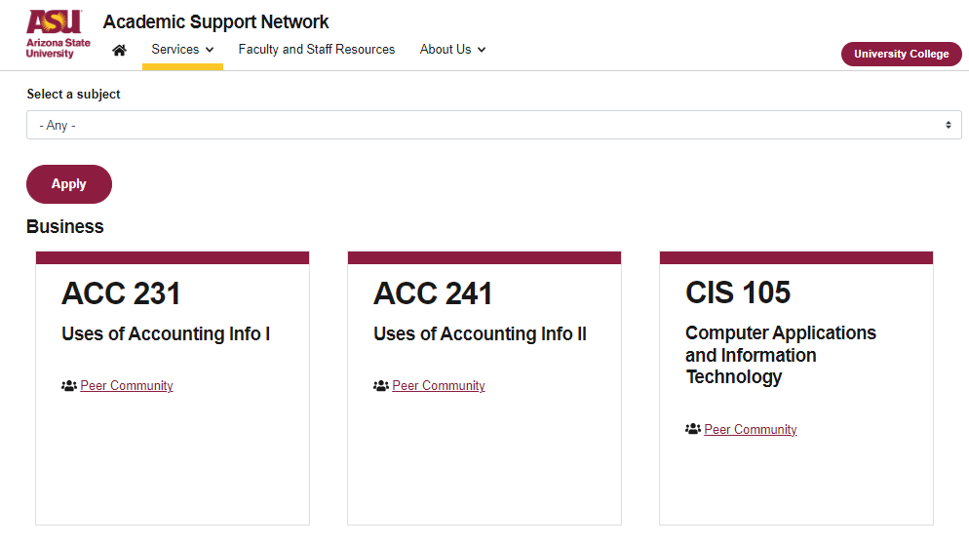

More Questions?
Check out our other resources!
tutoring.asu.edu/online-study-hub
Don’t forget to check out the Online Study Hub for additional resources!

Slide 39


Expanded Writing Support Available
Including Grammarly for Education, at no cost!
tutoring.asu.edu/expanded-writing-support
*Available slots for this pilot are limited

Slide 40
Additional Resources
Course Repo
Course Discord
BMP File Format (Wiki)
Linux Kernel API
Bootlin - Linux Cross Referencer
Dining Philosophers Interactive
Producer/Consumer Visual
Dave’s Garage Memory Video

